Slide 1
EVALUATING CLIMATE CHANGE IMPACTS ON HUMAN MORTALITY IN KOREAN CITIES: CHALLENGES AND FINDINGS
Laurence Kalkstein
Department of Public Health Sciences
Miller School of Medicine
University of Miami
Kyu Rang Kim, Jin Ah Kim, and Ji Sun Lee
National Institute of Meteorological Research
Korea Meteorological Administration
Scott Sheridan and Cameron Lee
Department of Geography
Kent State University

Slide 2
Goals
Determine changes in excessive heat episodes (EHEs) that are expected to occur in Seoul using selected climate change models and emissions scenarios.
Estimate increases in heat-related mortality over decadal periods in the 21st century.
Point out challenges that created need to re-develop the evaluation from study we did last year.

Slide 3
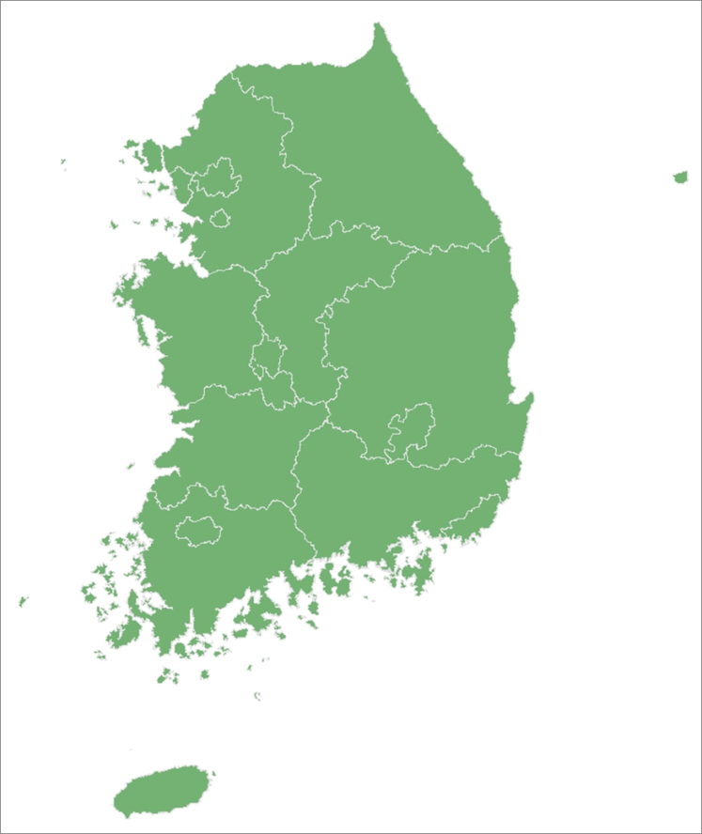
Largest Cities in Korea
(Population: 2010)
Seoul (9.79 million)
Busan (3.41 million)
Incheon (2.64 million)
Daegu (2.53 million)
Daejeon (1.50 million)
Gwangju (1.47 million)
Incheon
Seoul
Daejeon
Daegu
Gwangju
Busan
All have existing synoptic-based heat health watch warning systems in operation.

Slide 4
The Present Day as a Context
At present, Seoul mortality increases by an average of 7 percent during DT and MT+ days.
The DT air mass occurs during an average summer on 7.3 percent of days in Seoul, and the MT+ average occurrence is 1.3 percent.
We estimate that there have been over 1500 heat-related deaths during the 16 year period between 1991 to 2006 in Seoul.
That averages to about 100 deaths per summer.
Notes:
These results are based upon research from previous collaborative agreements between NIMR and Applied Climatologists, Inc. We have submitted a manuscript to the International Journal of Climatology which outlines these results.

Slide 5
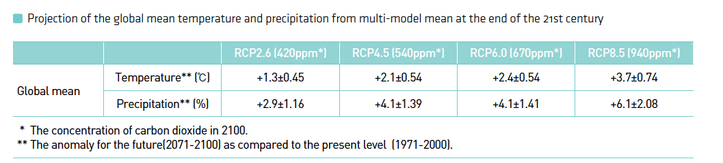
The Climate Change Scenarios
Two scenarios used, RCP 2.6 (RCP26) and RCP 8.5 (RCP85).
These represent the most conservative and most aggressive scenarios in the suite (HadGEM2-AO global climate model; Jones et al., 2010).
RCP26 assumptions about stabilizing emissions (CO₂ concentration 420ppm in 2100) are much more optimistic and hopefully much more realistic than RCP85 (CO₂ concentration 940ppm in 2100).
Mean temperature increases over the next century for RCP26 are about 1/3 that forecast by RCP85, and increases in precipitation are about half the magnitude in the former.
Notes:
Scenarios were provided directly by NIMR.

Slide 6
Comparison of Observed vs. Modeled Air Mass Frequencies: 2006-2012
 |  | % Summer Days
 |  | DM | DP | DT | MT+ | MT++
Busan 2006-2012 | Observed | 22.50 | 0.27 | 0.14 | 8.20 | 1.23
 | Modeled RCP26 | 21.07 | 1.79 | 0.95 | 4.05 | 0.24
 | Modeled RCP85 | 19.52 | 0.83 | 2.38 | 3.93 | 0.24
Daegu 2006-2012 | Observed | 23.10 | 0.96 | 22.40 | 6.15 | 0.27
 | Modeled RCP26 | 43.10 | 2.14 | 1.31 | 2.50 | 0.12
 | Modeled RCP85 | 31.90 | 1.07 | 0.24 | 2.86 | 0.00
Seoul 2006-20012 | Observed | 31.25 | 1.37 | 7.38 | 1.23 | 0.00
 | Modeled RCP26 | 42.38 | 0.95 | 1.43 | 1.67 | 0.00
 | Modeled RCP85 | 36.55 | 1.55 | 2.26 | 2.14 | 0.12
Immediate problems! There are some differences between observed and modeled scenario frequencies; the largest ones are highlighted in yellow.
DT greatly underestimated for both scenarios in Daegu and Seoul.
MT+ significantly underestimated for both scenarios in Busan and Daegu.
Underestimation in offensive air masses yields overestimation in comfortable DM air mass, particularly in Daegu RCP26.
Impact on scenario estimates for future decades unknown.
Notes:
Considering that the scenarios underestimate the oppressive air mass frequencies for the historical period of 2006-2012 and overestimate the DM air mass in Daegu and Seoul, it is tempting to say that the future scenario estimates might be conservative because of the overestimation of DM. However, we have no way to prove that, so it is probably best to just say that the impact on future scenario estimates is unknown.

Slide 7
Debiasing Modeled Dataset and SSC Development for Modeled Data
Need to debias dataset by removing the mean monthly model (GCM) bias at each grid point.
Done by comparing modeled historical data to NOAA/CIRES reanalysis data, which we considered “observed” data (thanks to NIMR Korea).
SSC for modeled data: defined circulation patterns for reanalysis, historical, & future GCM datasets.
PCA, k-means, regression and DFA were all used to define circulation patterns.
Historical relationships between CPs and SSC types were then extrapolated to GCM future data to get future SSC types (thanks to Lee and Sheridan, 2011).

Slide 8
Day by Day Matching Between “Observed” and Modeled SSC: Seoul
 |  | MODELED SSC
 |  | DM | DP | DT | MM | MP | MT | MT+ | MT++ | Total
OBS. SSC | DM | 2548 | 70 | 45 | 194 | 9 | 114 | 0 | 0 | 2980
 | DP | 175 | 213 | 2 | 10 | 12 | 0 | 0 | 0 | 412
 | DT | 194 | 1 | 92 | 30 | 1 | 55 | 2 | 0 | 375
 | MM | 313 | 1 | 10 | 1081 | 11 | 222 | 1 | 0 | 1639
 | MP | 71 | 12 | 0 | 50 | 52 | 2 | 0 | 0 | 187
 | MT | 180 | 0 | 26 | 306 | 0 | 592 | 12 | 1 | 1117
 | MT+ | 0 | 0 | 2 | 6 | 0 | 85 | 22 | 0 | 115
 | MT++ | 0 | 0 | 0 | 0 | 0 | 15 | 1 | 3 | 19
 | Total | 3481 | 297 | 177 | 1677 | 85 | 1085 | 38 | 4 | 6844
Actual daily matches occurred 67.3% of time, much better than last year’s analysis.
Many misclassified days into neighboring weather type (e.g. MT+ classified to MT).
35 of 38 modeled MT+ days classified into some observed MT category.

Slide 9
Decadal Matching Between “Observed” and Modeled SSC
ABS DEV | DM | DP | DT | MM | MP | MT | MT+ | MT++
1980s | 6.7% | 2.1% | 0.4% | 0.5% | 2.1% | 0.4% | 1.1% | 0.1%
1990s | 6.7% | 1.4% | 2.0% | 1.4% | 1.3% | 0.7% | 2.2% | 0.7%
2000s | 7.6% | 1.2% | 4.5% | 0.7% | 1.5% | 0.7% | 0.3% | 0.0%
2010s | 10.1% | 3.1% | 7.9% | 0.8% | 0.5% | 0.8% | 0.2% | 0.0%
AVG | 7.8% | 1.9% | 3.7% | 0.9% | 1.3% | 0.6% | 1.0% | 0.2%
Again, much better matching than last year’s project.
Dry air masses match worse with later decades; moist air masses match better for unknown reasons.
Nevertheless, matches are quite reasonable.

Slide 10
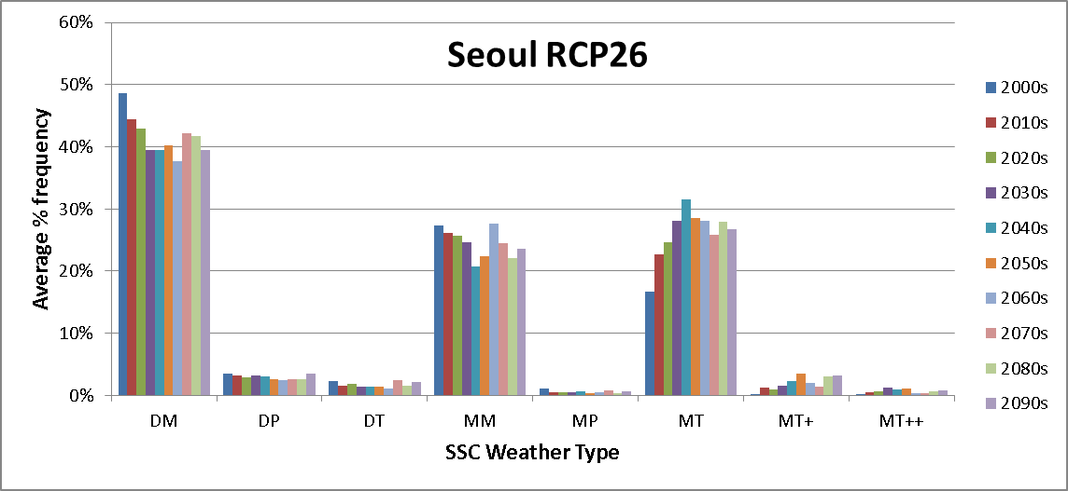
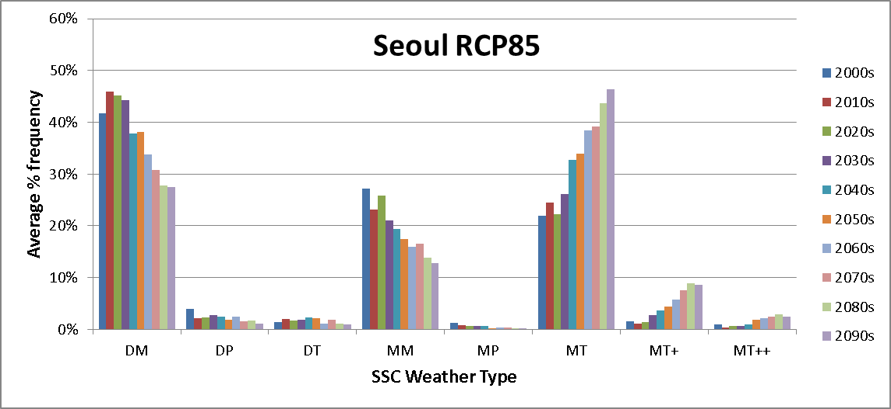
RCP 2.6 and 8.5 Results: Seoul

Slide 11
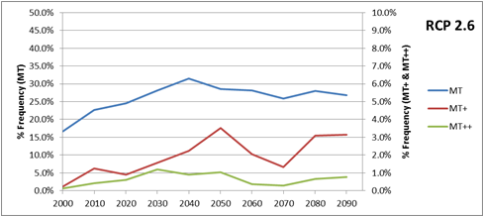
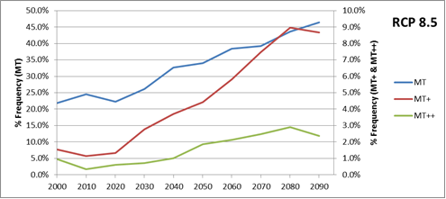
MT, MT+, MT++ Modeled Frequencies Through the Decades: Seoul

Slide 12
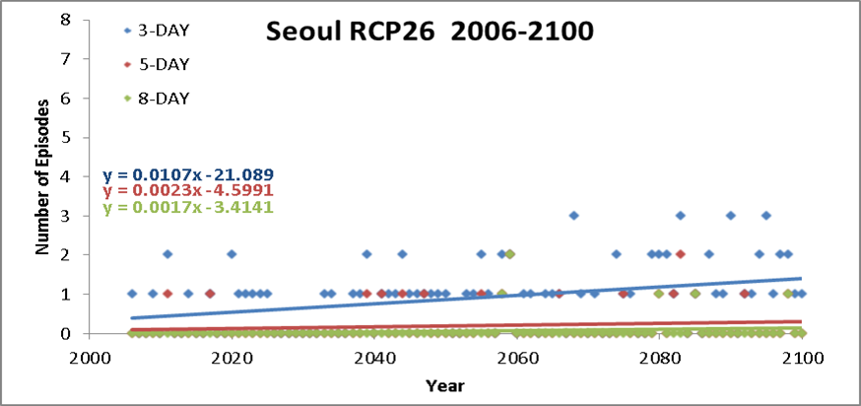
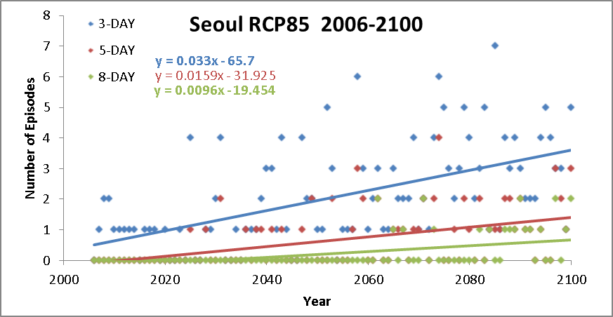
Consecutive Day Runs of Offensive Air Masses

Slide 13
Mortality Projections for Seoul
Daily mortality rates per 100,000 calculated from April-October, 1991-2012.
Temporal trends in these rates established; anomalous rates developed for each day.
Further adjustments are made to account for higher mortality rates and variability near start of the period. An adjustment was made as well to account for the seasonal cycle in mortality.
Mortality values calculated for three age groups; only total will be presented here.

Slide 14
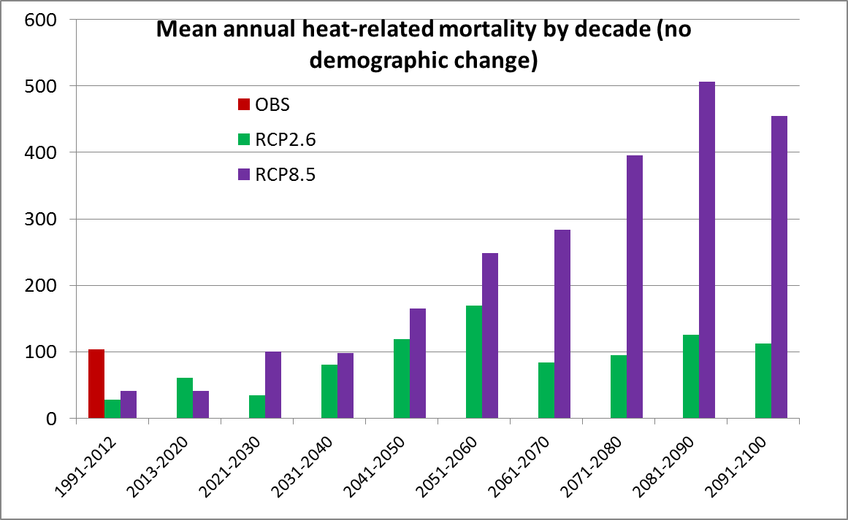
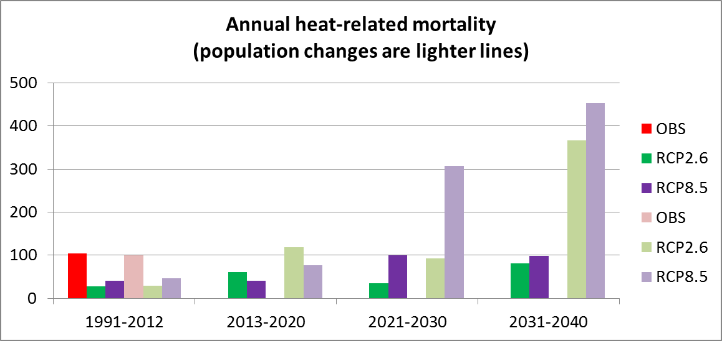
Mean Annual Heat Related Mortality by Decade With and Without Population Adjustment
Values increase irregularly through the period. Projected population growth might triple heat related mortality by mid-century.

Slide 15
Concluding Remarks
Procedures using circulation patterns for reanalysis, historical GCM, and projected GCM data can help increase SSC classification veracity for later decades.
Offensive air mass frequencies and multi-day episodes are estimated to increase, and more dramatically for business as usual scenario.
Heat-related mortality estimated to rise, and changes in demographics may greatly exacerbate increase.
Caveats: did not account for potential improvements in public awareness and intervention procedures, nor for acclimatization.

