Slide 1
Summer mortality, temperatures and synoptic climatology in Khabarovsk, Russian Far East
Elena A. Grigorieva
Institute for Complex Analysis of Regional Problems, Far Eastern Branch, Russian Academy of Sciences
L.S. Kalkstein
University of Miami, Miami, Florida, USA
S.C. Sheridan
Department of Geography, Kent State University, Kent, USA
J.K. Vanos
Department of Geosciences, Atmospheric Sciences Research Group, Texas Tech University, Lubbock, USA
ICB, Cleveland, September 28 – October 1, 2014

Slide 2
A climate assessment of the Russian Far East for the purpose of developing
Weather Health Warning System
Far Eastern Branch of Russian Academy of Sciences
CRDF Global
U.S. Civilian Research & Development Foundation
CRDF – FEB RAS Award RUG1-7062-BB-12

Slide 3
Introduction
Project “A climate assessment of the Russian Far East to develop Weather Health Warning Systems”
The ultimate aim is to construct a detailed climatology with unique climate indices for potential use in the development of heat warning systems that can save human lives during extreme weather.

Slide 4
Aim
Construct a detailed climatology of the Russian Far East using the Spatial Synoptic Classification system
Relate above to mortality (Khabarovsk as an example)

Slide 5
Study area
Study area southern Russian Far East:
Lat. 42 to 59°N and Long. 123 to 143° E
Climate: mid-latitude monsoon with extreme continental regime of annual temperatures and seasonal precipitation in continental part of study area

Slide 6
SSC Data
Summer 1966–2010
34 weather stations in the RFE
Surface based four-times daily observations
Air temperature
Dewpoint temperature
Wind speed and direction
Air pressure
Cloud cover

Slide 7
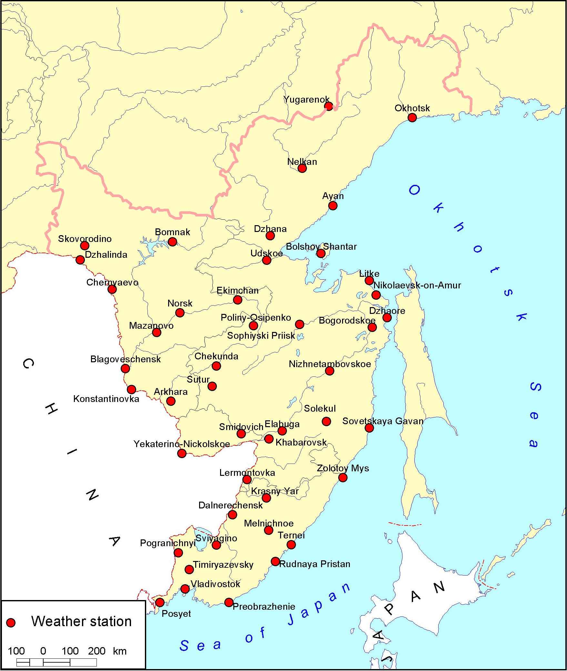
The southern part of the Russian Far East showing the location of weather stations

Slide 8
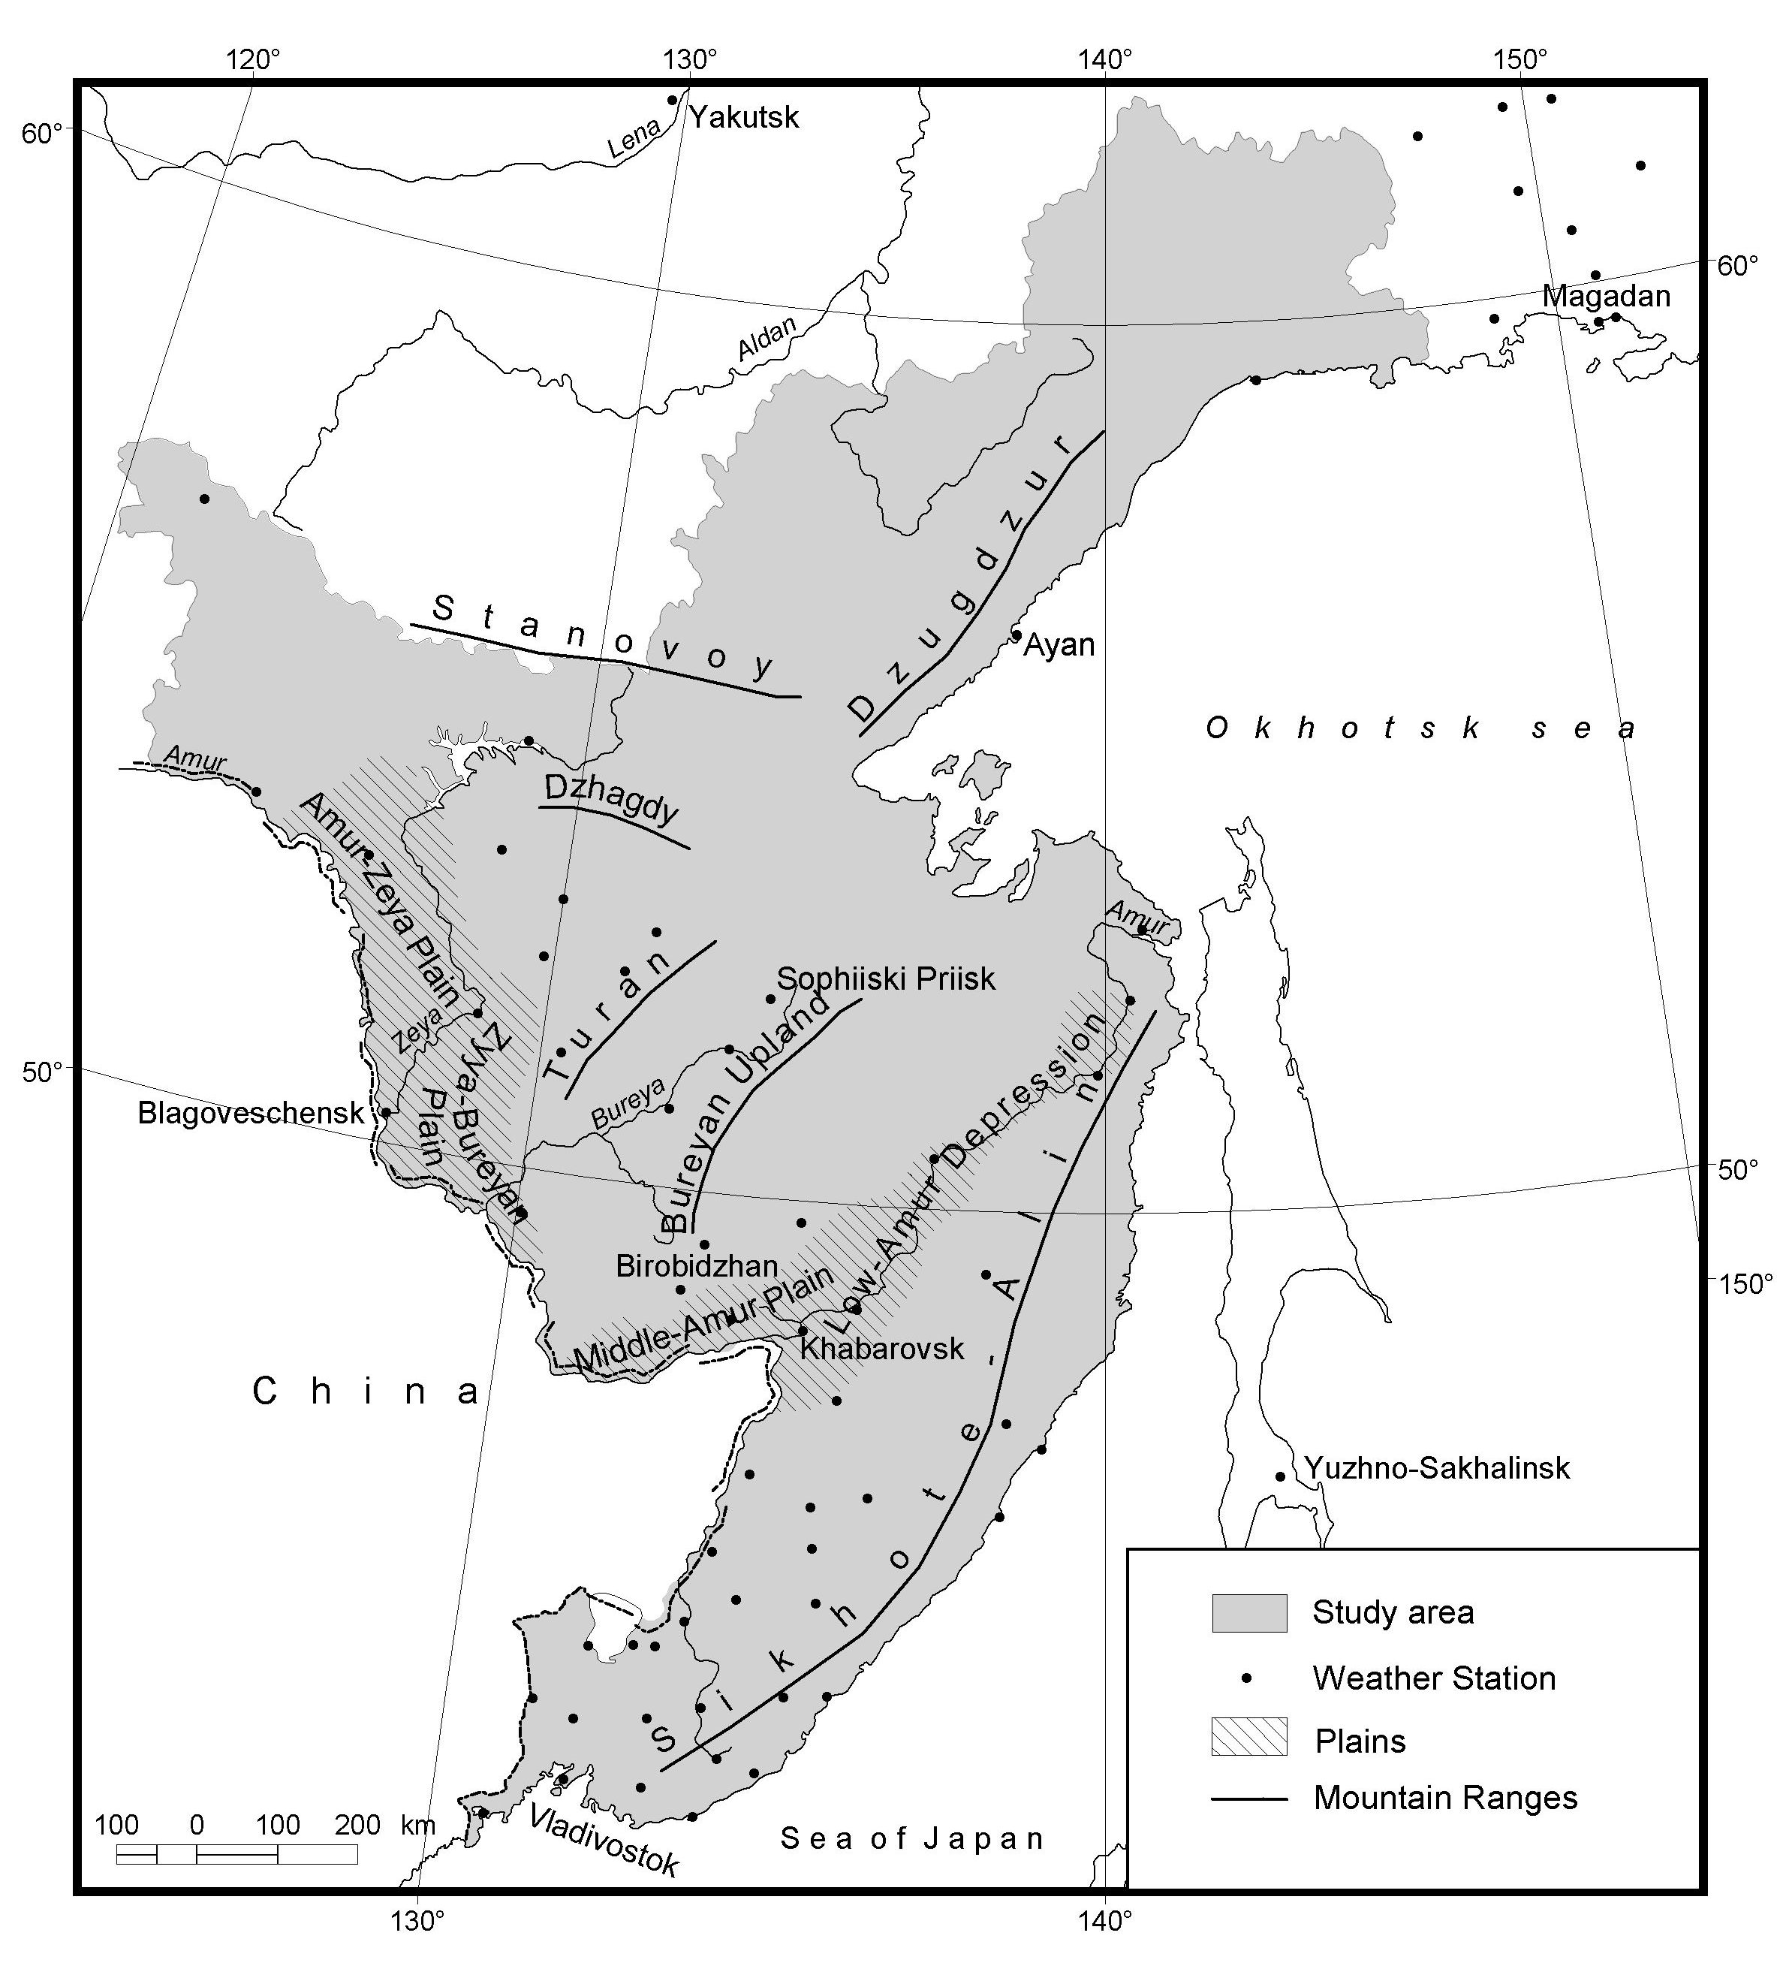
The southern RFE: topography

Slide 9
Data
Mortality data, Khabarovsk:
2000–2012
Daily all-cause mortality
Khabarovsk:
Population 593 636 (January, 1, 2013)
Absolute all-cause daily mortality:
23,0 cases / day (average for 2000-2012)
21,9 cases / day (average for period May – September)
21,7 cases / day (average for summer)

Slide 10
Method

Slide 11
Nomenclature
Days are classified into one of seven air mass types and frequencies over summer
SSC Air Mass Types
DP | Dry Polar
DM | Dry Moderate
DT | Dry Tropical
MP | Moist Polar
MM | Moist Moderate
MT | Moist Tropical
MT+, MT++ | Moist Tropical Plus
TR | Transition between air masses
Sheridan, S.C., 2002: The redevelopment of a weather-type classification
scheme for North American. Int. J. Climatology, 22, 51-68.
Kalkstein, L. S., Greene, S., Mills, D. M., & Samenow, J. 2011: An evaluation
of the progress in reducing heat-related human mortality in major US
cities. Natural Hazards, 56(1), 113-129.

Slide 12
U- or V-shaped temperature-mortality relationship
Optimal temperature with minimum mortality depends on climate (McMichael et al, 2008)
Netherland: 16,5 °С (Huynen et al, 2001)
Arkhangelsk, Moscow: 18 °С (Ревич, 2008; Варакина и др., 2011)
Montreal: 21°С (Frost et al, 1992)
Brisbane: 24 °С (Frost et al, 1992)
etc.

Slide 13
New York City Mortality Algorithm
Mortality = -37.4 + 8.82 DIS + 1.425 ATP - 0.11 TOS
  For either MT+ or DT
  DIS = day in sequence
  TOS = time of season (May 1st = 1, May 2nd = 2…)
  ATP = 5 pm Apparent temperature °C
Website URL: http://sheridan.geog.kent.edu/hwws/
Username: health Password: stress

Slide 14
Results

Slide 15
Daily temperature and mortality in summer, Khabarovsk, 2000-2012
SSC | T (°C) | T 3pm (°C) | SSC Frequency (%) | Mortality (M) | (M – Mmean) /Mmean (%) | (M – Mmean) /Mmean (%) 65+
MT+, MT++ | 25.2 | 29.3 | 3.8 | 24.2 | 12 | 22
MT | 21.8 | 26.7 | 15.7 | 22.3 | 3 | 3
MP | 14.6 | 16.3 | 7.5 | 20.1 | -7 | -7
MM | 18.9 | 21.3 | 26.8 | 21.0 | -3 | -1
DT | 19.3 | 27.4 | 7.8 | 23.9 | 10 | 14
DP | 13.3 | 18.5 | 2.6 | 21.5 | - 1 | 1
DM | 18.0 | 23.9 | 21.2 | 21.6 | -1 | -1
mean | 20.1 | 23.4 |  | 21.7 |  | 51

Slide 16
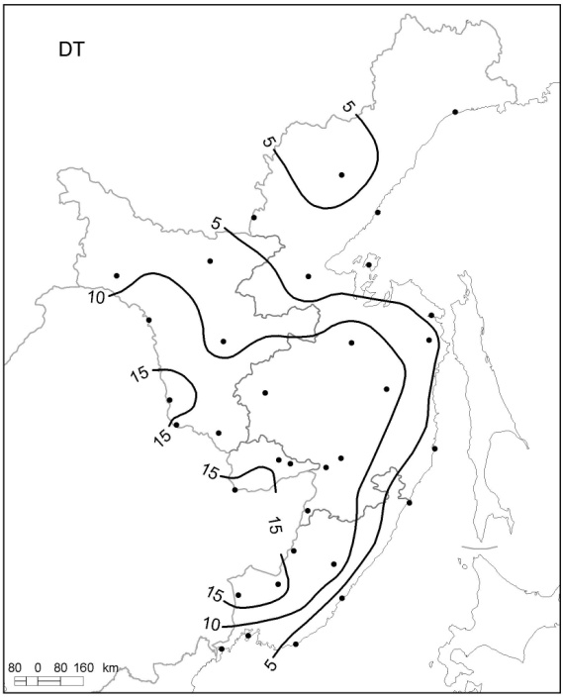
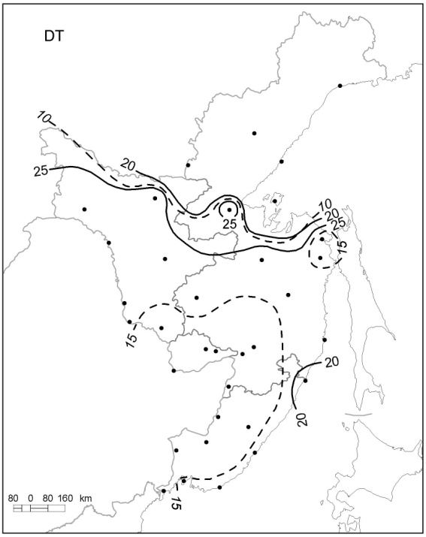
Dry Tropical air mass
1 – Frequencies 2 – Ta and Td

Slide 17
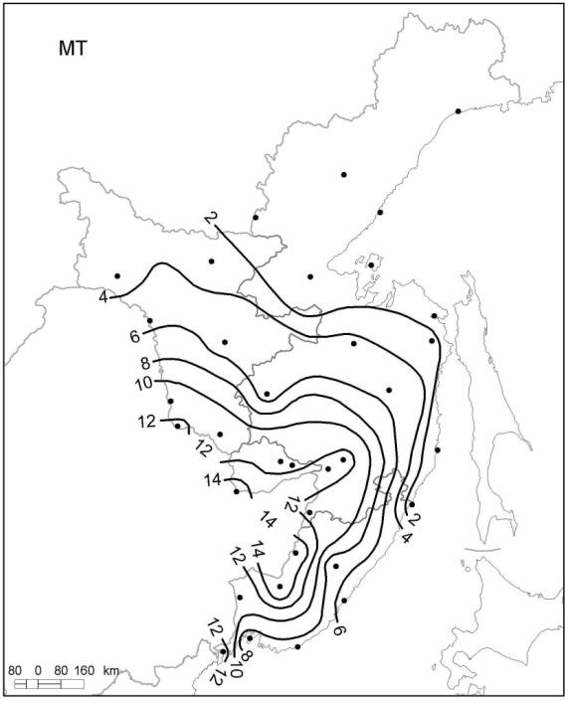
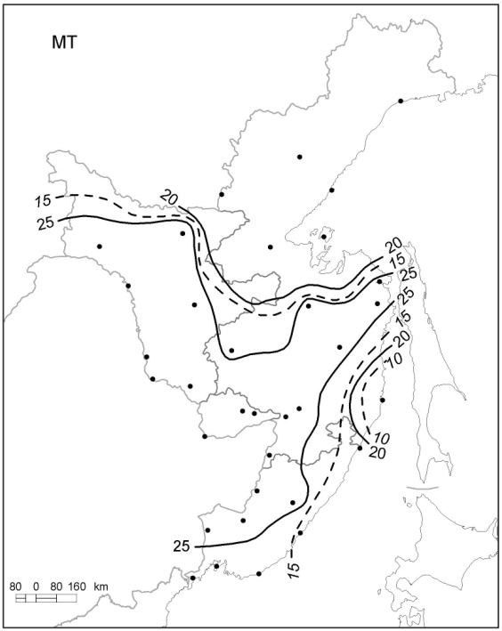
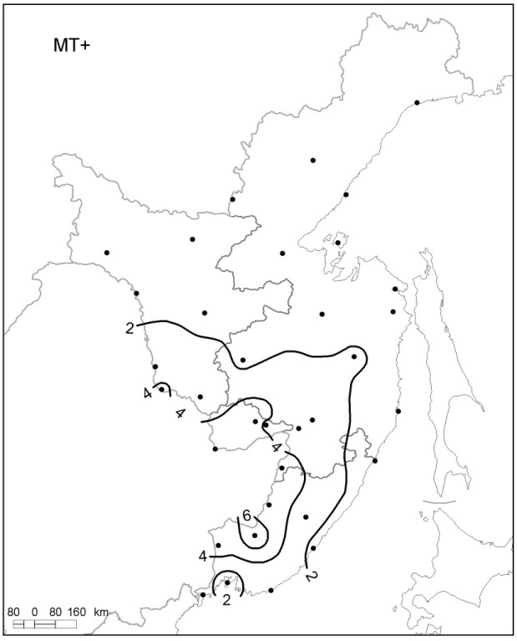
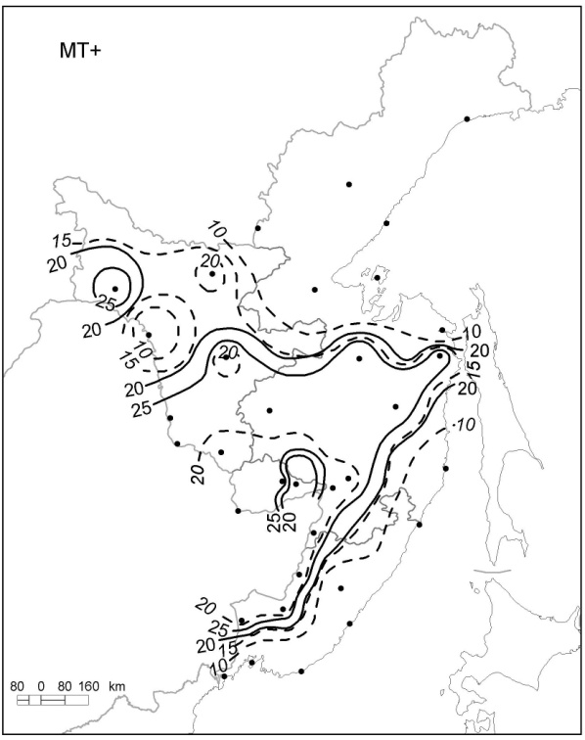
Moist Tropical air mass
Moist Tropical plus (+, ++) air mass
Frequencies Ta and Td

Slide 18
Summer 60 Year Air Mass Frequencies – Moist Tropical and Dry Polar, Khabarovsk
MT = 6.8 more days now than in the early 1950’s
DP =3 less days (this is over a 50% decrease in days)
Notes:
MT = 6.8 more days now than in the early 1950’s
DP =3 less days (this is over a 50% decrease in days)

Slide 19
Daily temperature and mortality, Khabarovsk,
2000-2012

Slide 20
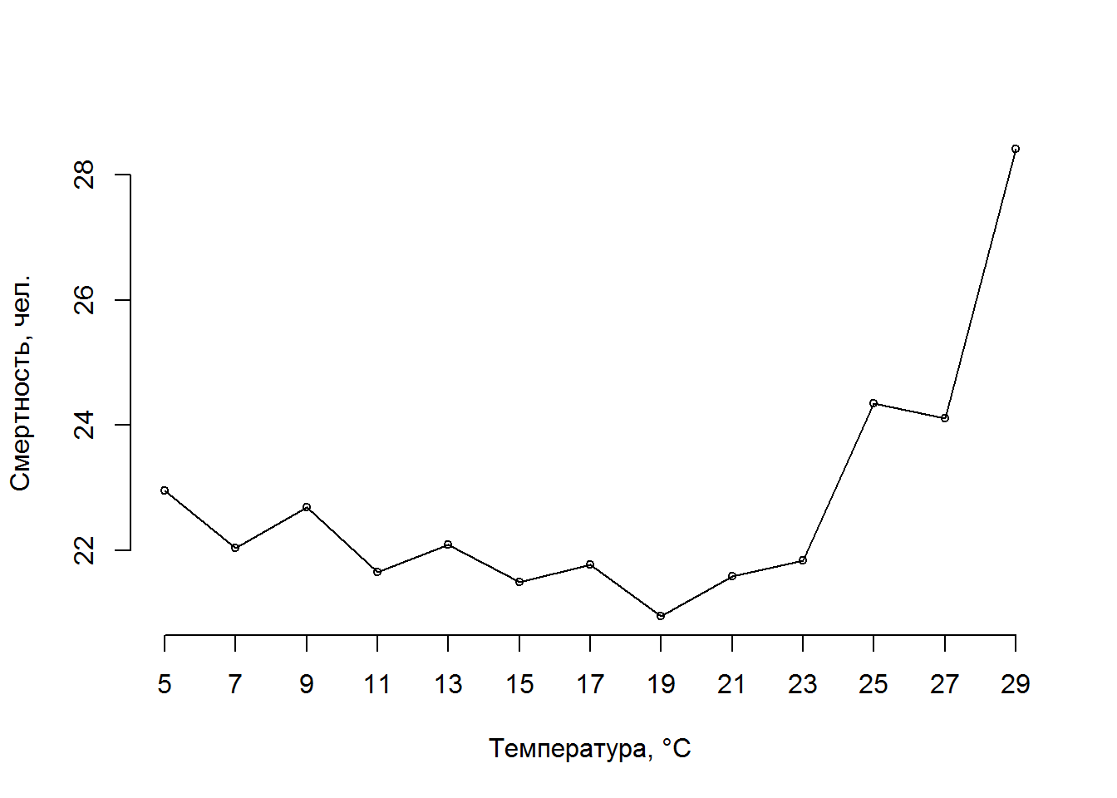
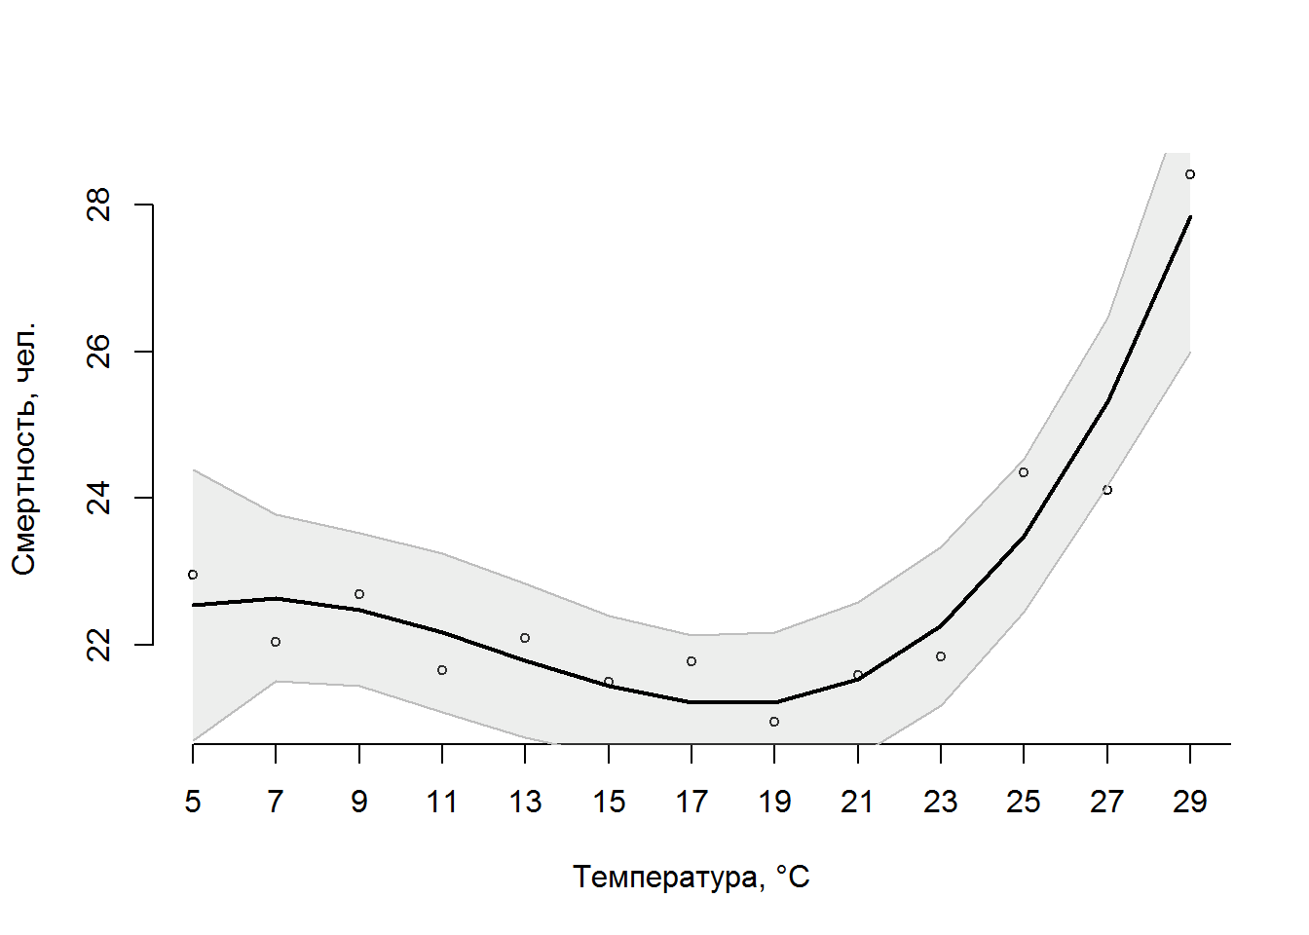
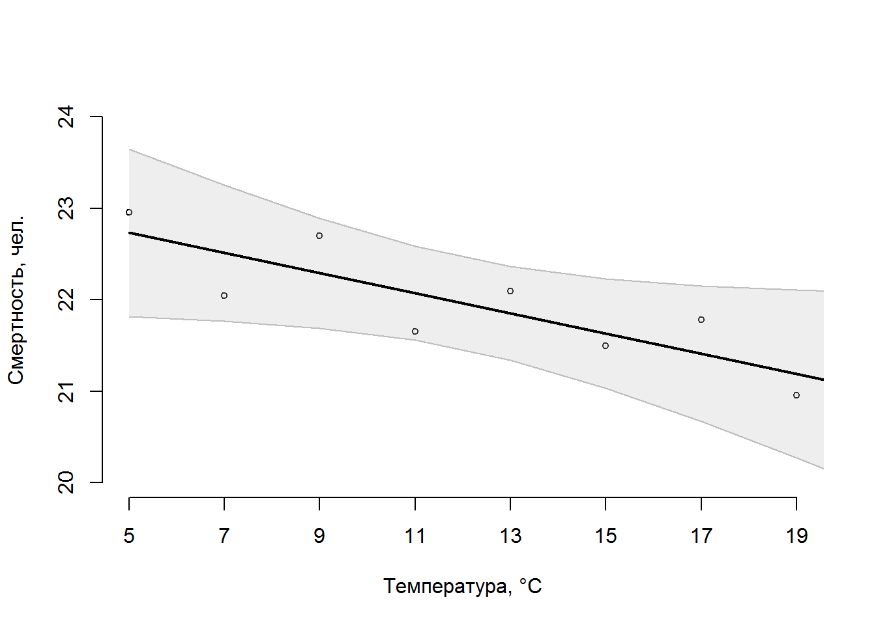
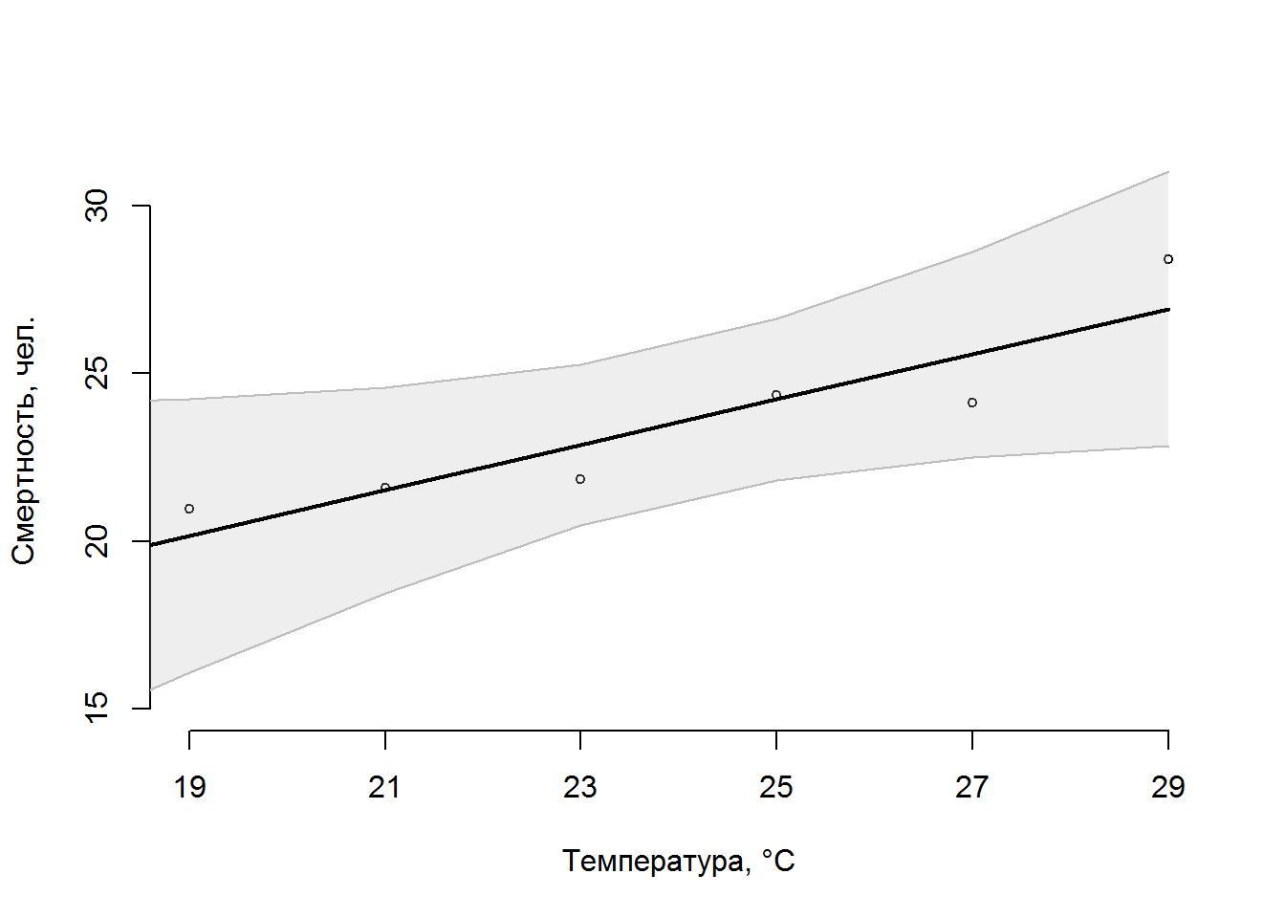
Daily temperature and mortality, Khabarovsk, 2000-2012, May – September
M = 23,28 – 0,11T
R² = 0,6989
M = 7,335 + 0,675T
R² = 0,842

Slide 21
Mortality Algorithm for Khabarovsk
Mortality = 18.836 – 0.007 TOS – 0.13 T_{mean} + 0.384 DTR + 0.321 AT
  For either MT+ or DT
  TOS = time of season (May 1st = 1, May 2nd = 2…)
  T_{min}, T_{mean}, T_{max} – air temperature, °C
  DTR = diurnal temperature range =T_{max} – T_{min} , °C
  AT = 3 pm Apparent temperature, °C

Slide 22
Conclusion
RFE in summer:
the most dominant air masses are Moist Moderate (MM) in the southwestern RFE, and Moist Polar (MP) in the northeastern part.
Dry Tropical (DT) and Moist Tropical plus (DT+, DT++), the most oppressive air masses, frequently occur in the Amur River area, separated from the Pacific Ocean by Sikhote-Alin and Dzhugdzhur Mountains.

Slide 23
Conclusion
In Khabarovsk frequencies of MT: 7 more days now than in the early 1950’s;
DP – 3 less days (this is over a 50% decrease in days)

Slide 24
Conclusion
A U-shaped temperature-mortality relationship is shown for Khabarovsk, with minimum mortality at a threshold temperature of +19 °С.
During summer, a 12% higher rate of all-cause mortality (22% for 65+) is associated with most offensive Moist Tropical plus (MT+, MT++) air mass, and a 10% (14% for 65+) higher rate – with Dry Tropical (DT).

Slide 25
Thank you for listening

